Slide 1
Content
1) Analysis with single source
Methodology [Section 10.1]
Two examples
2) Analysis with multiple sources (single frequency)
Nodal analysis [Section 10.2] (1 example)
Mesh analysis [Section 10.3] (1 example)
3) Analysis by superposition (multiple frequencies)
Circuits containing DC sources and AC sources of a single frequency (1 example)
Circuits containing multiple AC sources with different frequencies (1 example)
4) AC Power: Instantaneous vs. Average
Alexander & Sadiku,
“Fundamentals of Electric Circuits”
7th Edition Chapters 9 &10

Slide 2
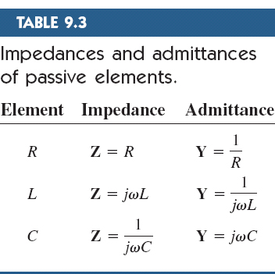
General methodology
Transform the circuit to the frequency domain
Transform AC sources from time domain sinusoids to phasor form
Work out impedances for a given frequency ω
Solve the problem using circuit techniques
Transform phasor form solutions back to time domain
$$v\left(t\right)=V_{m}\cos\left(ωt+∅\right)⇔V=V_{m}∠∅$$
(Time-domain representation)
(Phasor-domain representation)

Slide 3
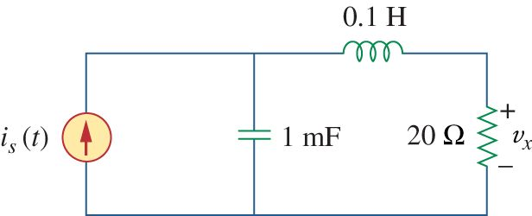

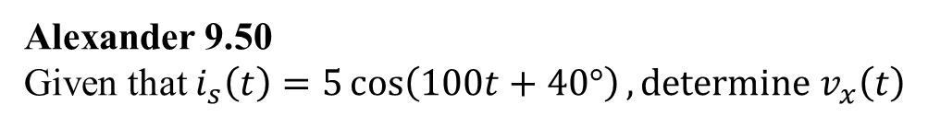
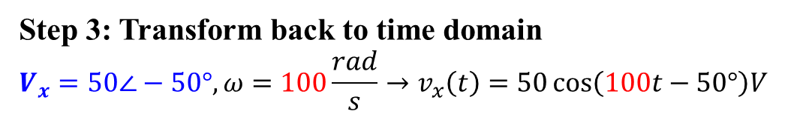
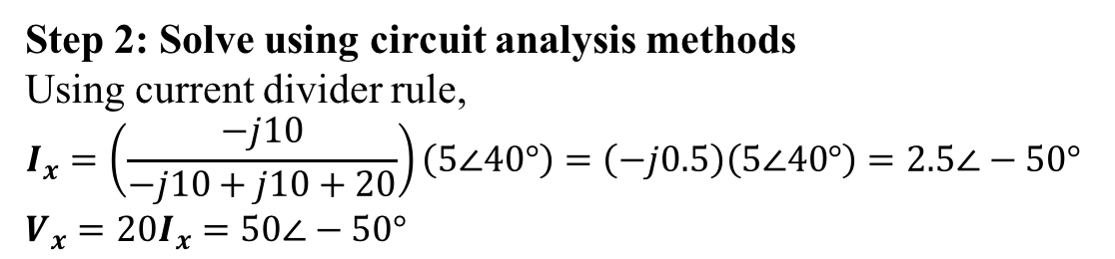
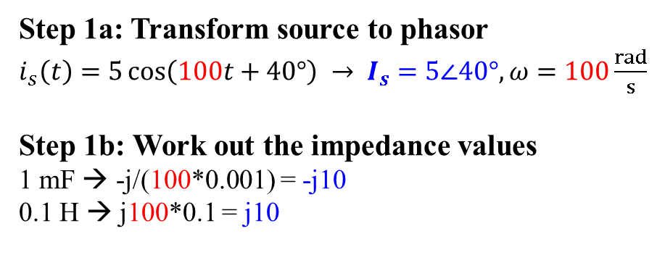
1A) Single source analysis example 1
Alexander 9.50
Given that $i_{s}\left(t\right)=5\cos\left(100t+40°\right), determine v_{x}\left(t\right)$
j10
Ix
Step 1a: Transform source to phasor
$i_{s}\left(t\right)=5\cos\left(100t+40°\right) →$ $I_{s}=5∠40°,ω=100\frac{rad}{s}$
Step 1b: Work out the impedance values
1 mF → -j/(100*0.001) = -j10
0.1 H → j100*0.1 = j10
$$I_{s}=5∠40°$$
-j10
Step 2: Solve using circuit analysis methods
Using current divider rule,
$$I_{x}=\left(\frac{−j10}{−j10+j10+20}\right)\left(5∠40°\right)=\left(−j0.5\right)\left(5∠40°\right)=2.5∠−50°$$
$$V_{x}=20I_{x}=50∠−50°$$
Step 3: Transform back to time domain
$$V_{x}=50∠−50°,ω=100\frac{rad}{s}→v_{x}\left(t\right)=50\cos\left(100t−50°\right)V$$

Slide 4
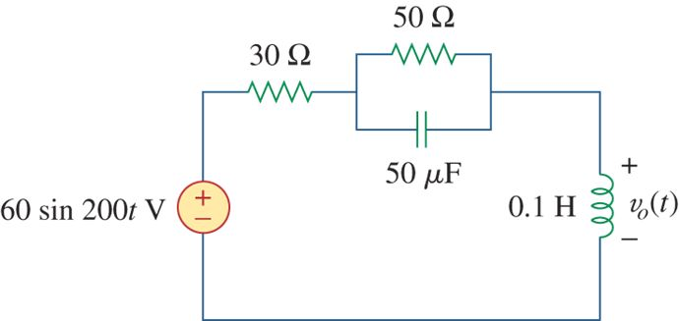
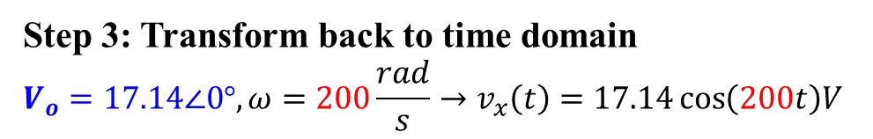
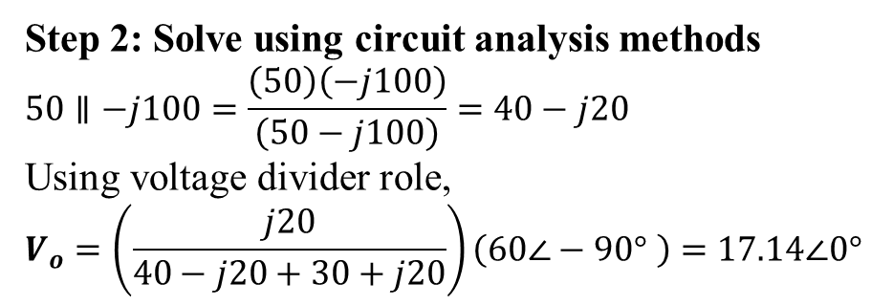
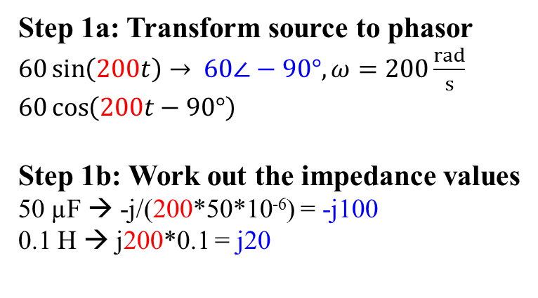
1B) Single source analysis example 2
Alexander 9.42
Determine v_{o}(t)
Step 1a: Transform source to phasor
$60\sin\left(200t\right)→$ $60∠−90°,ω=200\frac{rad}{s}$
$$60\cos\left(200t−90°\right)$$
Step 1b: Work out the impedance values
50 µF → -j/(200*50*10⁻⁶) = -j100
0.1 H → j200*0.1 = j20
-j100
j20
Step 2: Solve using circuit analysis methods
$$50∥−j100=\frac{\left(50\right)\left(−j100\right)}{\left(50−j100\right)}=40−j20$$
Using voltage divider role,
$$V_{o}=\left(\frac{j20}{40−j20+30+j20}\right)\left(60∠−90° \right)=17.14∠0°$$
Step 3: Transform back to time domain
$$V_{o}=17.14∠0°,ω=200\frac{rad}{s}→v_{x}\left(t\right)=17.14\cos\left(200t\right)V$$

Slide 5
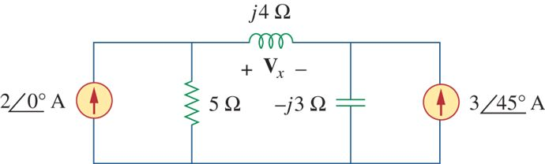
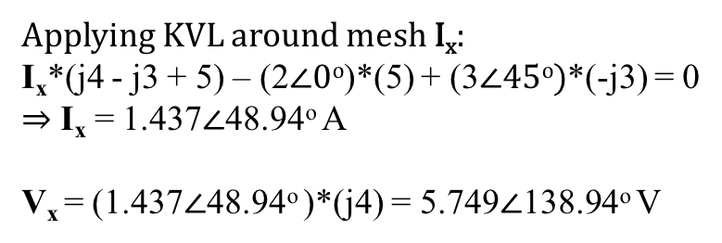
2A) Single freq multiple sources example 1
Focus only on STEP 2 (solving by circuit techniques) in this example
Alexander 10.16
Use MESH CURRENT ANALYSIS to find V_{x}
I_{x}
Applying KVL around mesh I_{x}:
I_{x}*(j4 - j3 + 5) – (2$∠0o$)*(5) + (3$∠45o)$*(-j3) = 0
$⇒$ I_{x} = 1.437$∠$48.94º A
V_{x} = (1.437$∠$48.94º )*(j4) = 5.749$∠$138.94º V

Slide 6
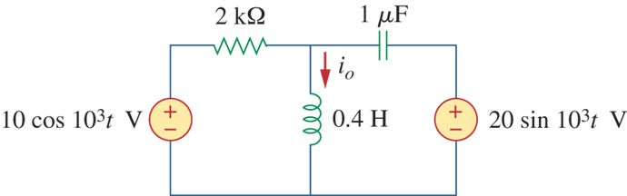
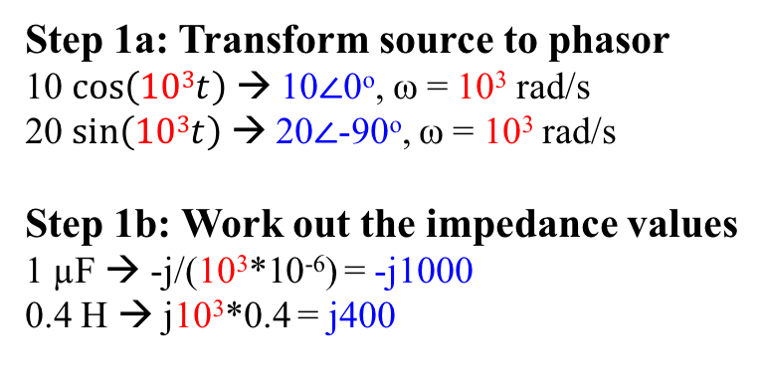


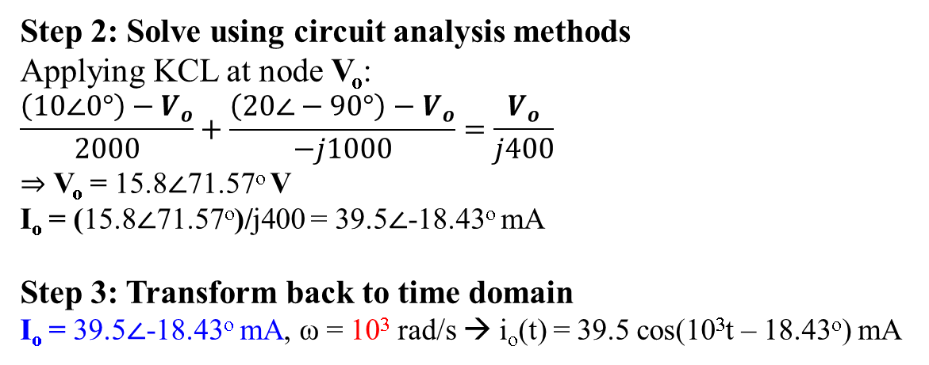
2B) Single freq multiple sources example 2
Alexander 10.26
Use nodal voltage analysis to find i_{o}(t)
Step 1a: Transform source to phasor
10 $\cos\left(103t\right)$ → 10$∠$0º, ω = 10³ rad/s
20 $\sin\left(103t\right)$ → 20$∠$-90º, ω = 10³ rad/s
Step 1b: Work out the impedance values
1 µF → -j/(10³*10⁻⁶) = -j1000
0.4 H → j10³*0.4 = j400
V_{o}
-j1000
10$∠$0º
20$∠$-90º
j400
Step 2: Solve using circuit analysis methods
Applying KCL at node V_{o}:
$$\frac{\left(10∠0°\right)−V_{o}}{2000}+\frac{\left(20∠−90°\right)−V_{o}}{−j1000}=\frac{V_{o}}{j400}$$
$⇒$ V_{o} = 15.8$∠$71.57º V
I_{o} = (15.8$∠$71.57º)/j400 = 39.5$∠$-18.43º mA
Step 3: Transform back to time domain
I_{o} = 39.5$∠$-18.43º mA, ω = 10³ rad/s → i_{o}(t) = 39.5 cos(10³t – 18.43º) mA

Slide 7
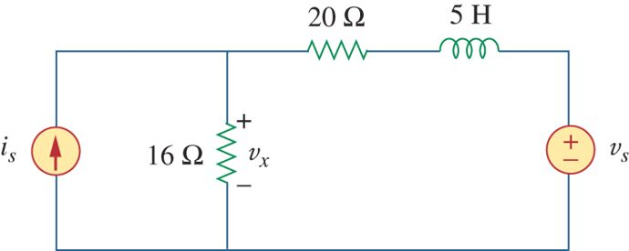
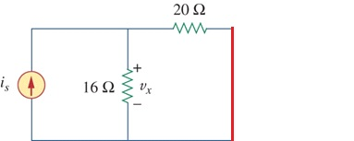
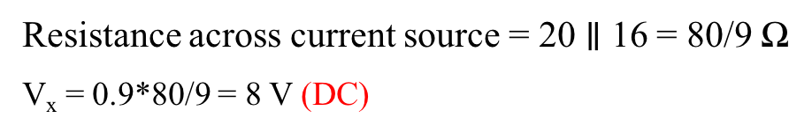
3A) Superposition (multiple freq) example 1
Alexander 10.44 (Modified)
Given v_{s}(t) = 50cos(2t) and i_{s} = 0.9 A, find v_{x}(t)
Method: Analyze circuit one frequency at a time
In the case, first analyze at DC then at 2 rad/s and then add up the two solutions (superposition)
At DC, redraw circuit without v_{s}(t):
Replace voltage source with short circuit
Replace inductor with short circuit
Resistance across current source = 20 $∥$ 16 = 80/9 Ω
V_{x} = 0.9*80/9 = 8 V (DC)

Slide 8
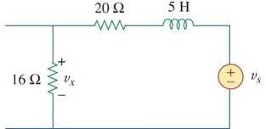

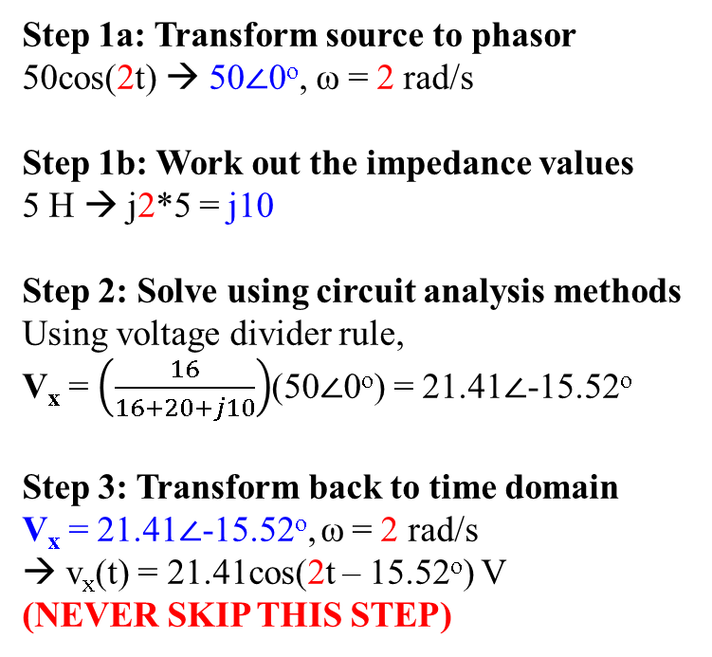
3A) Superposition (multiple freq) example 1
Alexander 10.44 (Modified)
Given v_{s}(t) = 50cos(2t) and i_{s} = 0.9 A, find v_{x}(t)
Step 1a: Transform source to phasor
50cos(2t) → 50$∠$0º, ω = 2 rad/s
Step 1b: Work out the impedance values
5 H → j2*5 = j10
Step 2: Solve using circuit analysis methods
Using voltage divider rule,
V_{x} = $\left(\frac{16}{16+20+j10}\right)$(50$∠$0º) = 21.41$∠$-15.52º
Step 3: Transform back to time domain
V_{x} = 21.41$∠$-15.52º, ω = 2 rad/s
→ v_{x}(t) = 21.41cos(2t – 15.52º) V
(NEVER SKIP THIS STEP)
At 2 rad/s, redraw circuit without i_{s}:
Replace current source with open circuit
j10
50$∠$0º
Final step: Add up both solutions
v_{x}(t) = 21.41cos(2t – 15.52º) + 8 V
Note that there are 2 terms in the final form (one at DC and another at 2 rad/s)

Slide 9
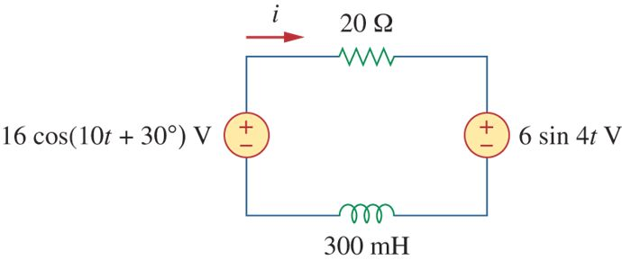
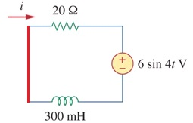
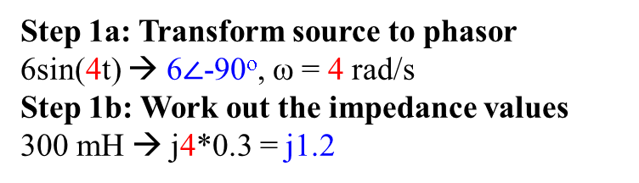
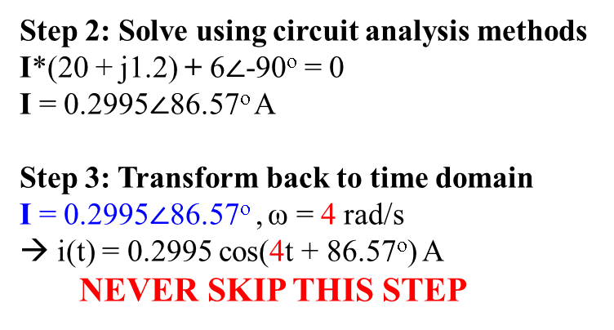
3B) Superposition (multiple freq) example 2
Alexander 10.45
Find i(t)
Method: Analyze circuit one frequency at a time
In the case, first analyze at 4 rad/s then 10 rad/s.
Finally, add up the two solutions (superposition)
At 4 rad/s, redraw circuit without 10 rad/s source:
Replace 10 rad/s voltage source with short circuit
Step 2: Solve using circuit analysis methods
I*(20 + j1.2) + 6$∠$-90º = 0
I = 0.2995$∠$86.57º A
Step 3: Transform back to time domain
I = 0.2995$∠$86.57º , ω = 4 rad/s
→ i(t) = 0.2995 cos(4t + 86.57º) A
NEVER SKIP THIS STEP
Step 1a: Transform source to phasor
6sin(4t) → 6$∠$-90º, ω = 4 rad/s
Step 1b: Work out the impedance values
300 mH → j4*0.3 = j1.2

Slide 10
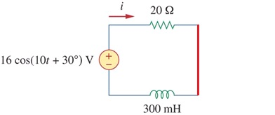

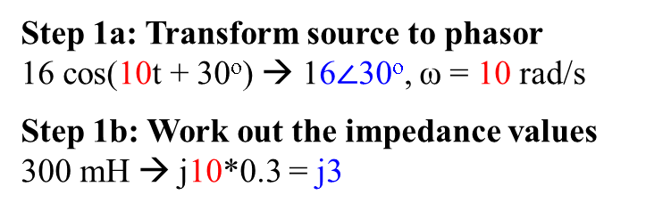
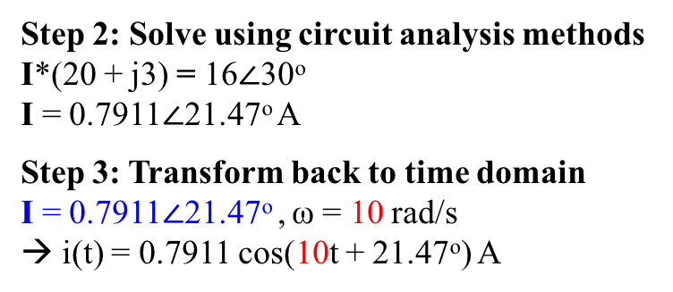
3B) Superposition (multiple freq) example 2
Alexander 10.45
Find i(t)
At 10 rad/s, redraw circuit without 4 rad/s source:
Replace 4 rad/s voltage source with short circuit
16$∠$30º
j3
Step 2: Solve using circuit analysis methods
I*(20 + j3) = 16$∠$30º
I = 0.7911$∠$21.47º A
Step 3: Transform back to time domain
I = 0.7911$∠$21.47º , ω = 10 rad/s
→ i(t) = 0.7911 cos(10t + 21.47º) A
Step 1a: Transform source to phasor
16 cos(10t + 30º) → 16$∠$30º, ω = 10 rad/s
Step 1b: Work out the impedance values
300 mH → j10*0.3 = j3
NEVER SKIP THIS STEP
Final step: Add up both solutions
i(t) = 0.2995 cos(4t + 86.57º) + 0.7911 cos(10t + 21.47º) A
Note that there are 2 terms in the final form (one at 4 rad/s and another at 10 rad/s)

Slide 11
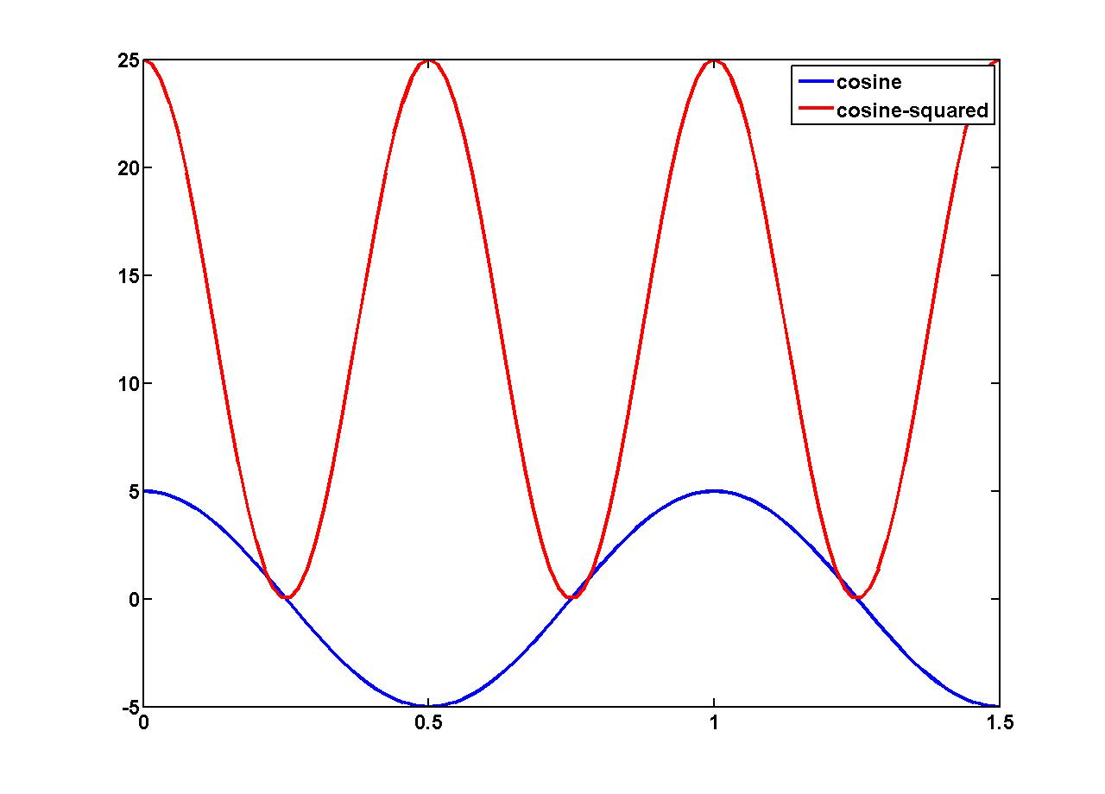
AC Power: Instantaneous vs. Average
Although the average voltage across a resistor with a sinusoidal AC voltage across it is zero, note that the average power dissipated is not zero. Since P = V²/R, we should consider the square of the voltage.
The following graph shows the voltage across a 1Ω resistor in blue and the corresponding square of this voltage in red. The red curve therefore shows the INSTANTANEOUS POWER.
The instantaneous power is clearly sinusoidal with a DC offset:
V²(t) = 5² * 0.5 * (1 + cos(4πt))
= V_{peak}² * 0.5 * cos(4πt) +
V_{peak}² * 0.5
= 12.5cos(4πt) + 12.5
V²(t) = 5²cos²(2πt) V
Mean of V² = 12.5 (DC offset)
Average power of V²(t) is 12.5 W
Average power of V²(t) = 0.5 * V_{peak}²
V(t) = 5cos(2πt) V
Mean of V = 0

Slide 12
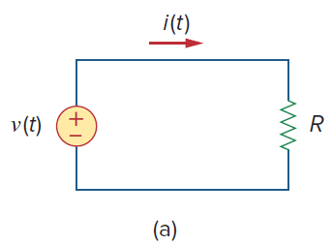

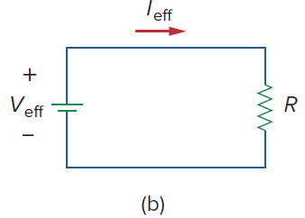


Effective or RMS Value
The average power absorbed by the resistor in the ac circuit of Fig. (a) is
To find the dc effective current I_{eff} (Fig. (b)) that will transfer the same power to resistor R as the sinusoid i(t):
Equating these two expressions of P and solving for I_{eff}, we obtain

Slide 13



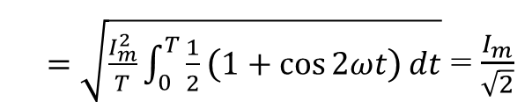
Effective or RMS Value
The effective value of the voltage is found in the same way as current, i.e.,
This indicates that the effective value is the square root of the mean (or average) of the square of the periodic signal. Therefore, the effective value is known as the root-mean-square (rms) value. We write
For the sinusoid i(t) = I_{m} cos ωt, the effective or rms value is
$=\sqrt{\frac{I_{m}^{2}}{T}\int_{0}^{T}{\frac{1}{2}\left(1+\cos{2ωt}\right)}dt}$ = $\frac{I_{m}}{\sqrt{2}}$

Slide 14


Effective or RMS Value
Similarly, for v(t) = V_{m} cos ωt:
Note: The simple formulas for V_{rms} and I_{rms} are only valid for sinusoidal signals.
The average power absorbed by the resistor R in the previous simple circuit (Fig.(a) and (b)) can be written as

